Slide 3
Texas Parks & Wildlife Department
& Land Conservation Program
Mission & Functions
Texas Farm & Ranch Lands
Conservation Program
Council Meeting
January 28, 2016

Slide 4
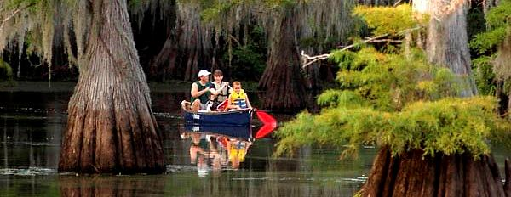
Mission of TPWD
To manage and conserve the natural and cultural resources of Texas and to provide hunting, fishing and outdoor recreation opportunities for the use and enjoyment of present and future generations

Slide 5
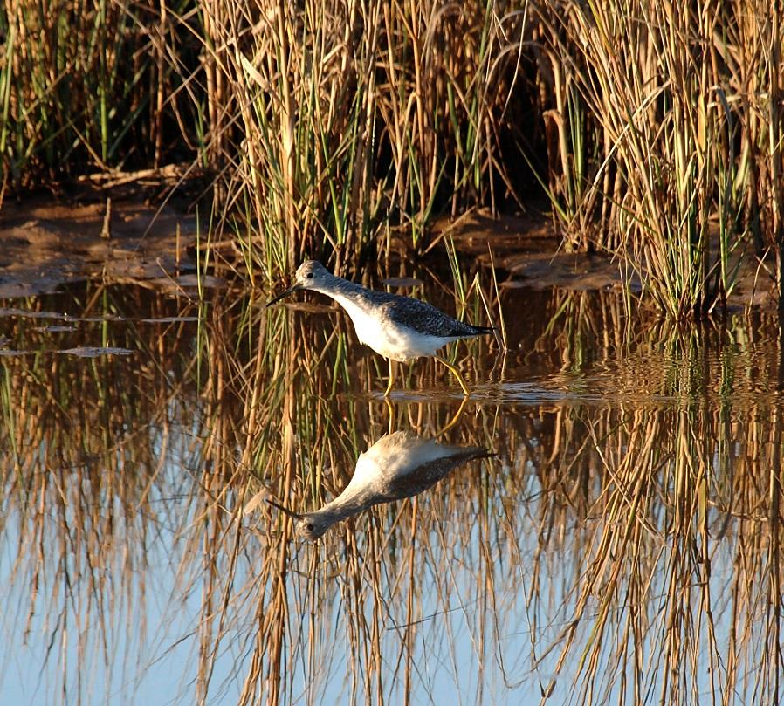
TPWD History
1895: Texas Fish and Oyster Commission established
1907: Game Department added
1923: Texas State Parks Board established
1963: Entities merged creating Texas Parks & Wildlife Department (TPWD)
TPWD consists of 11 Divisions plus the Executive Office

Slide 6
TPWD Conservation Efforts
TPWD manages approximately 1.4 million acres
96 State Parks = ~ 625,000 acres
55 Wildlife Management Areas = ~ 771,000 acres
Range of efforts to encourage and support good stewardship of private lands
Private lands biologists
Managed Lands and related game management programs
Landowner Incentive Program (LIP)
Wildscape program targeting urban and suburban lands
Texas Farm & Ranch Lands Conservation Program (TFRLCP)

Slide 7
The Land Conservation Program
Housed within the Executive Office
Provides land conservation services to all TPWD
Acquisitions and dispositions
Boundary agreements and dispute resolution
Third-party surface uses such as oil and gas exploration and recovery, easements and licenses
Land ownership and surface use records
Staff includes Director, Senior Project Manager, State Parks Specialist, Asset Manager and Staff Services Officer

Slide 8
Management of the TFRLCP
Oversight and decision-making provided by the Council
Council Chairman: TPWD Commissioner S. Reed Morian
Land Conservation Director: Ted Hollingsworth
Legal services: TPWD Staff Attorney Bob Sweeney
Support team: Project Management Office Director Jeannie Muñoz and Staff Services Officer Carla Beavers
Project review committee: T. Birdsong, J. Dreibelbis, C. Kuhlmann, J. Raasch, and T. Hollingsworth
Grant administrator: TBD

Slide 9
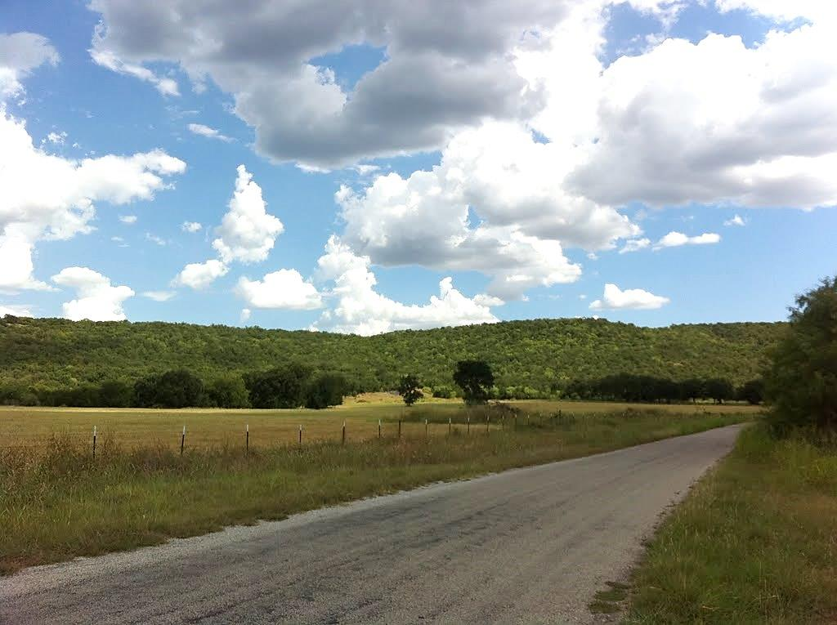
Questions?

